Slide 1

Circuit Theorems
Discussion D2.5
Sections 2-9, 2-11

Slide 2
Circuit Theorems
Linear Circuits and Superposition
Thevenin's Theorem
Norton's Theorem
Maximum Power Transfer

Slide 3
Linear Circuits
A linear circuit is one whose output is directly proportional to its input.
Linear circuits obey both the properties of homogeneity (scaling) and additivity.

Slide 5
Superposition Principle
Because the circuit is linear we can find the response of the circuit to each source acting alone, and then add them up to find the response of the circuit to all sources acting together. This is known as the superposition principle.
The superposition principle states that the voltage across (or the current through) an element in a linear circuit is the algebraic sum of the voltages across (or currents through) that element due to each independent source acting alone.

Slide 6
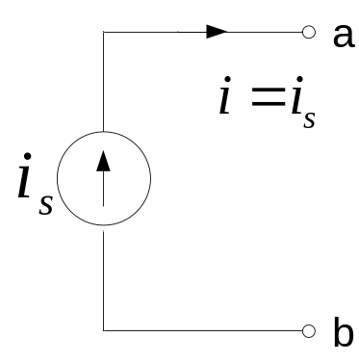

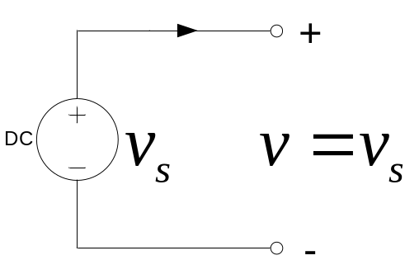

Turning sources off
Current source:
We replace it by a current source where
An open-circuit
Voltage source:
We replace it by a voltage source where
i
An short-circuit

Slide 7
Steps in Applying the Superposition Principle
Turn off all independent sources except one. Find the output (voltage or current) due to the active source.
Repeat step 1 for each of the other independent sources.
Find the total output by adding algebraically all of the results found in steps 1 & 2 above.
In some cases, but certainly not all, superposition can simplify the analysis.

Slide 8
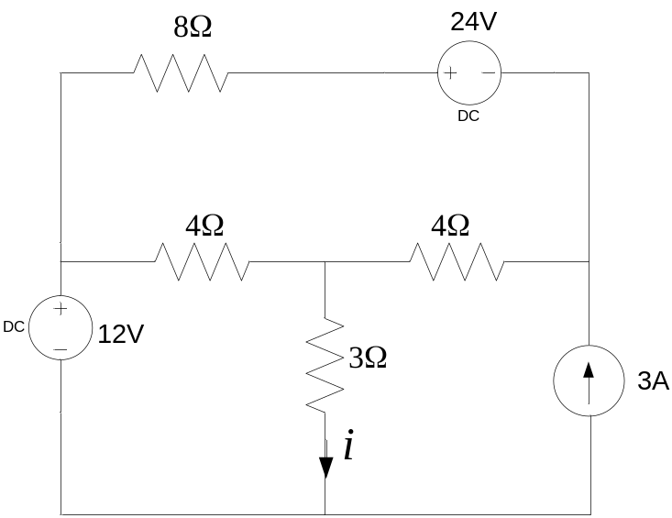
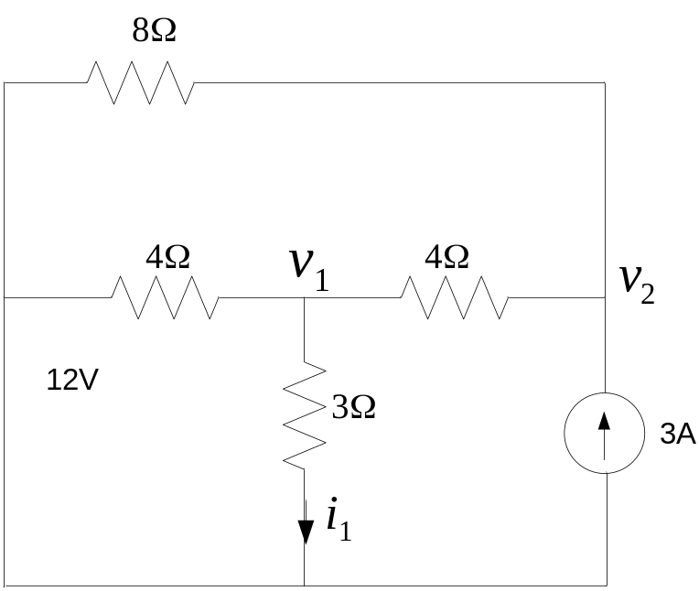
Example: In the circuit below, find the current i by superposition
Turn off the two voltage sources (replace by short circuits).

Slide 9
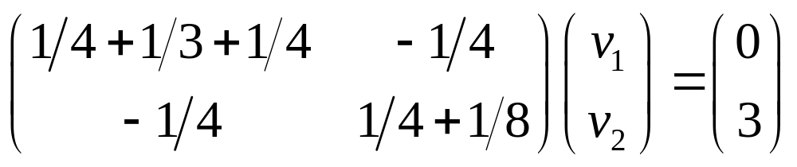
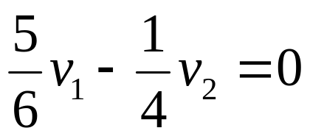
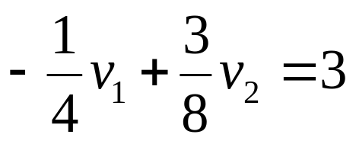
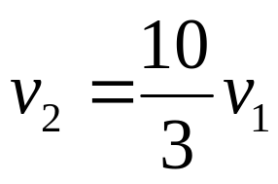
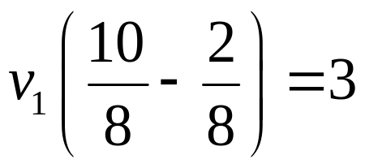
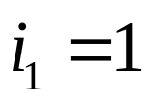
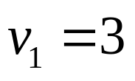

Slide 10
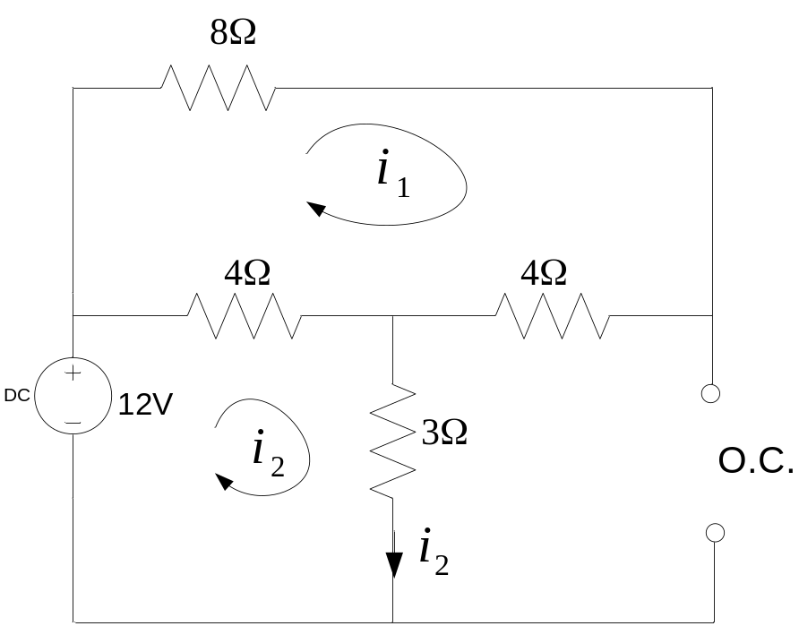
Example: In the circuit below, find the current i by superposition
Turn off the 24V & 3A sources:

Slide 11
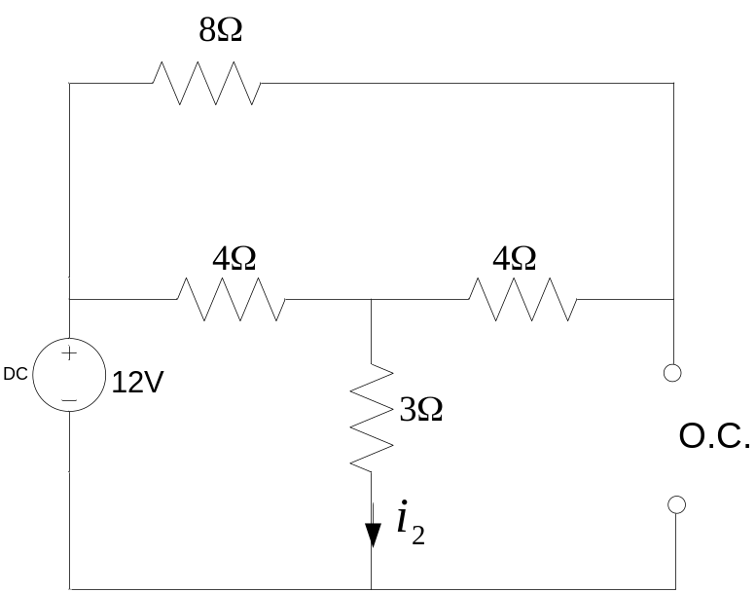
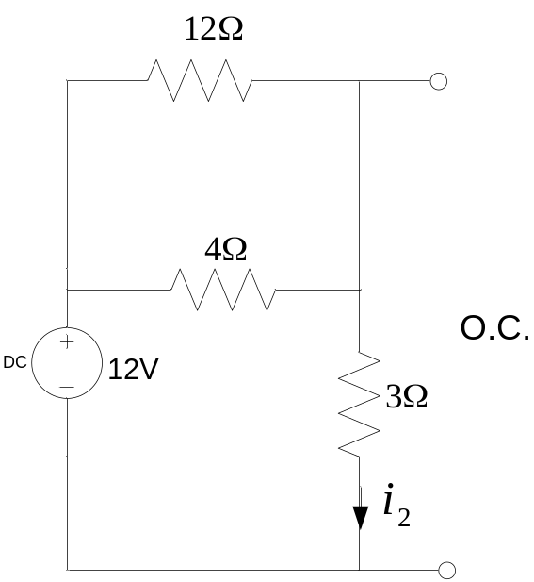
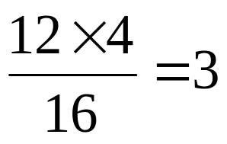
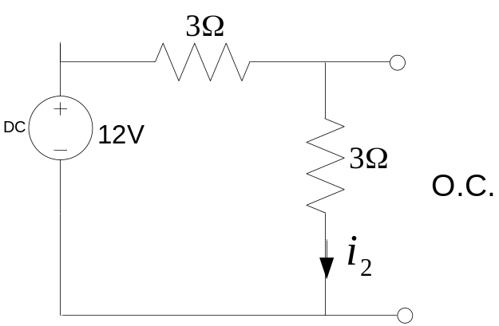
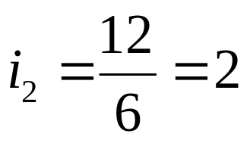

Slide 12
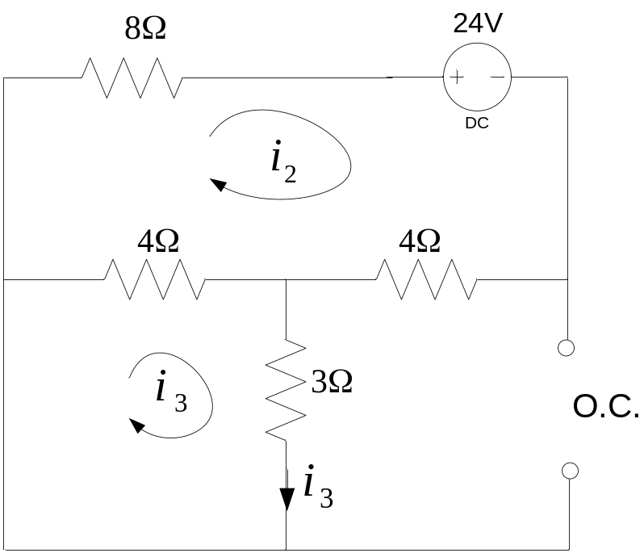
Example: In the circuit below, find the current i by superposition
Turn off the 3A & 12V sources:

Slide 13
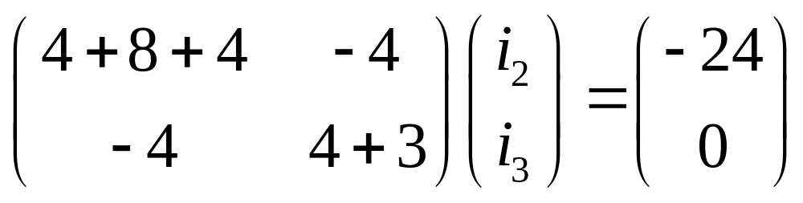
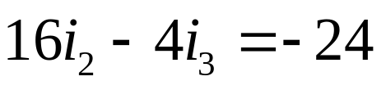
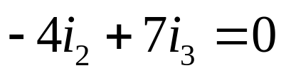
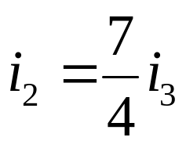
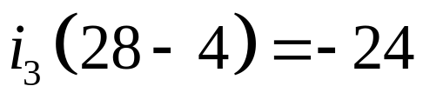
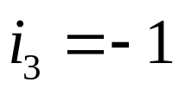

Slide 14
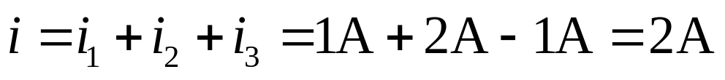
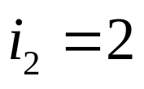

Slide 15
Circuit Theorems
Linear Circuits and Superposition
Thevenin's Theorem
Norton's Theorem
Maximum Power Transfer

Slide 16
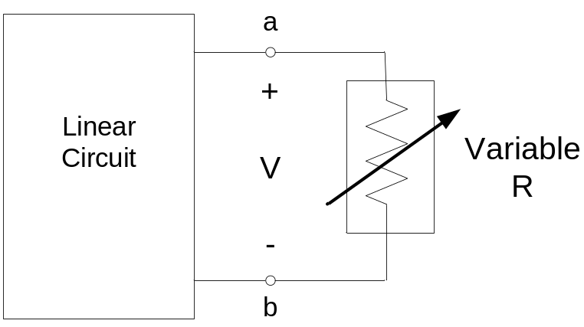
Thevenin's Theorem
In many applications we want to find the response to a particular element which may, at least at the design stage, be variable.
Each time the variable element changes we have to re-analyze the entire circuit. To avoid this we would like to have a technique that replaces the linear circuit by something simple that facilitates the analysis.
A good approach would be to have a simple equivalent circuit to replace everything in the circuit except for the variable part (the load).

Slide 17
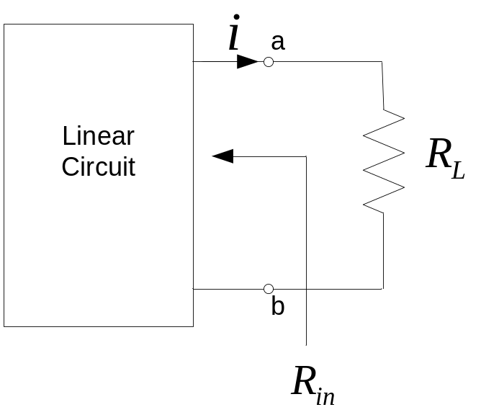
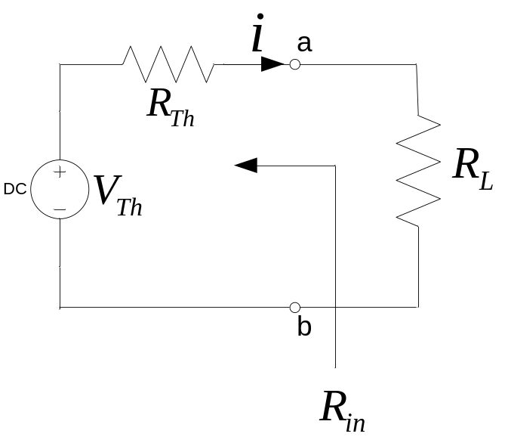
Thevenin's Theorem
Thevenin’s theorem states that a linear two-terminal resistive circuit can be replaced by an equivalent circuit consisting of a voltage source V_{Th} in series with a resistor R_{Th}, where V_{Th} is the open-circuit voltage at the terminals, and R_{Th} is the input or equivalent resistance at the terminals when the independent sources are all turned off.

Slide 18
Thevenin's Theorem
Thevenin’s theorem states that the two circuits given below are equivalent as seen from the load R_{L} that is the same in both cases.
V_{Th} = Thevenin’s voltage = V_{ab} with R_{L} disconnected (= ∞) = the open-circuit voltage = V_{OC}

Slide 19
Thevenin's Theorem
R_{Th} = Thevenin’s resistance = the input resistance with all independent sources turned off (voltage sources replaced by short circuits and current sources replaced by open circuits). This is the resistance seen at the terminals ab when all independent sources are turned off.

Slide 20
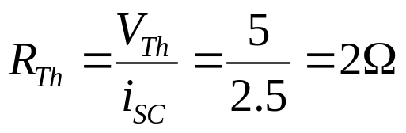
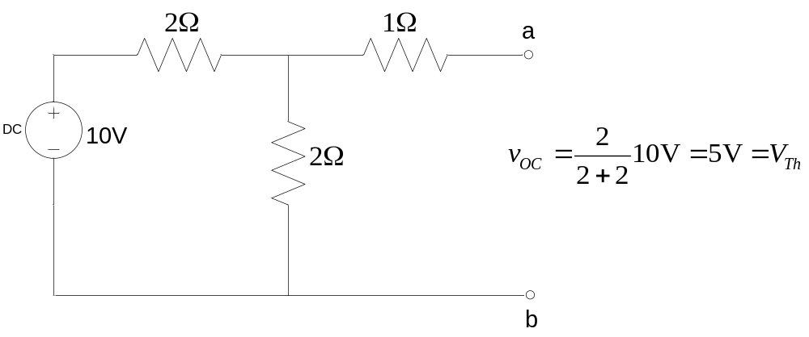
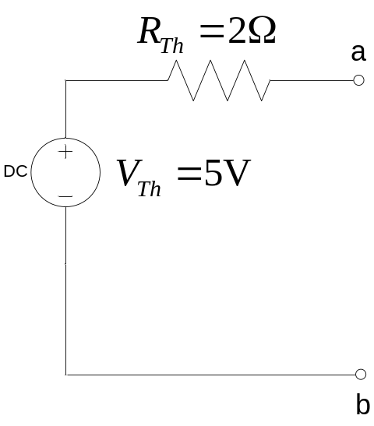
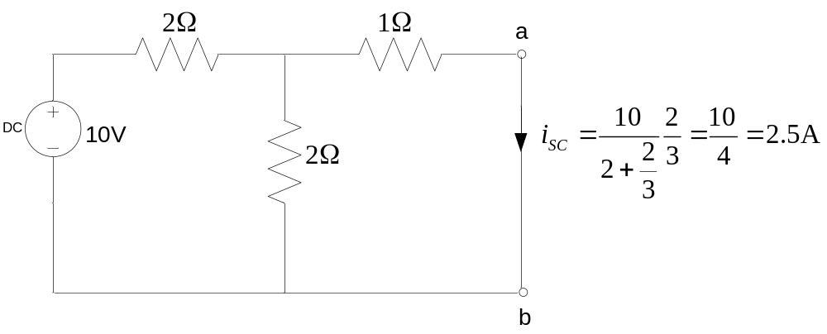
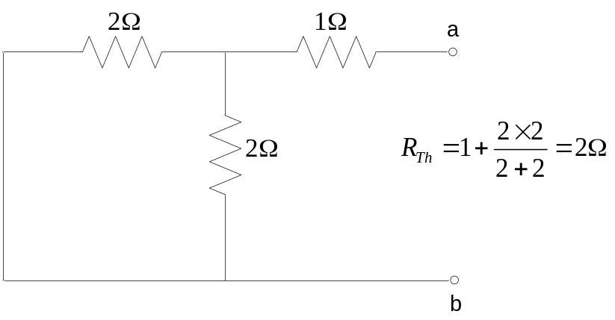
Example

Slide 21
Circuit Theorems
Linear Circuits and Superposition
Thevenin's Theorem
Norton's Theorem
Maximum Power Transfer

Slide 22
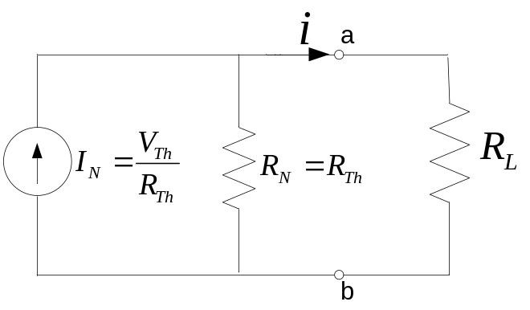
Norton's Theorem
Norton’s equivalent circuit can be found by transforming the Thevenin equivalent into a current source in parallel with the Thevenin resistance. Thus, the Norton equivalent circuit is given below.
Formally, Norton’s Theorem states that a linear two terminal resistive circuit can be replaced by an equivalent circuit consisting of a current source I_{N} in parallel with a resistor R_{N}, where I_{N} is the short-circuit current through the terminals, and R_{N} is the input or equivalent resistance at the terminals when all independent sources are all turned off.

Slide 23
Circuit Theorems
Linear Circuits and Superposition
Thevenin's Theorem
Norton's Theorem
Maximum Power Transfer

Slide 24
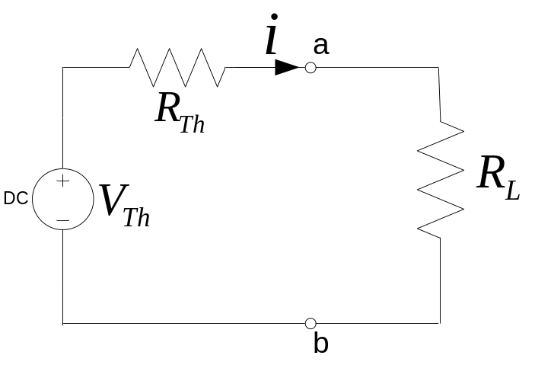
Maximum Power Transfer
In all practical cases, energy sources have non-zero internal resistance. Thus, there are losses inherent in any real source. Also, in most cases the aim of an energy source is to provide power to a load. Given a circuit with a known internal resistance, what is the resistance of the load that will result in the maximum power being delivered to the load?
Consider the source to be modeled by its Thevenin equivalent.

Slide 25
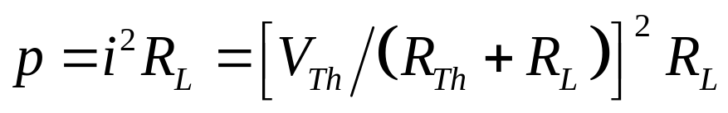
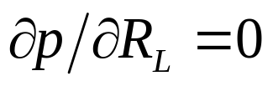
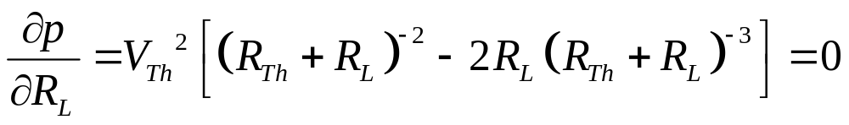
The power delivered to the load (absorbed by R_{L}) is
This power is maximum when

Slide 26

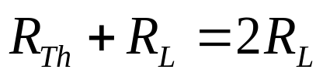
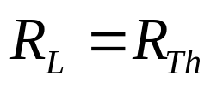
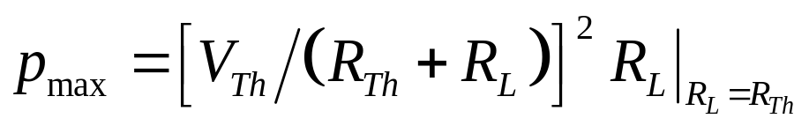
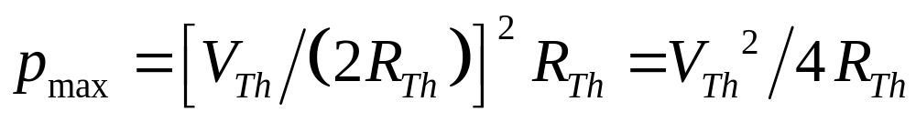
Thus, maximum power transfer takes place when the resistance of the load equals the Thevenin resistance R_{Th}. Note also that
Thus, at best, one-half of the power is dissipated in the internal resistance and one-half in the load.

